Slide 1
2020 Year in Review
Prepared for the Board
February 11, 2021

Slide 2
Annual Call Volume
Notes:
Total call volume decreased by 6%. EMS call volume decreased by 14.5%.

Slide 3
Call Volume by Quarter
Notes:
In Q1 of 2020, our medic call volume dropped by 3.5%. In Q2 it dropped by an additional 9.4%. In Q3 things opened up over the summer and medical call volume increased by 16%, back to historical averages. In Q4 we shut down again and medic call volume once again dropped by 11.25%, essentially back down to Q2 levels.

Slide 4
EMS Call Response
Goal is to have ambulance on scene of “emergent” calls within 8 minutes 90% of the time in town.
In 2020 we complied with this 94% of the time
2018 was 93% and 2019 was 92%
For rural responses, goal is to have a member of the District on scene within 15 minutes 70 of the time.
In 2020 we complied with this 67% of the time
2018 was 70% and 2019 was 69%

Slide 5
Structure Fire Response
Goal is to have 6 on scene in 9 minutes 80% of the time in town
In 2020 we complied 83% of the time (5/6)
The only time we did not was the one time that M-91 was not available
Goal is to have 2 on scene in 14 minutes 70% of the time for rural structure fires
In 2020 we complied 100% of the time (4/4)
All of these responses happened to be in 90’s first due

Slide 6
Other Standards
Fewer structure fires per capita than the State
.37 per 1,000 vs the 3 yr State average of .97
Less property loss per capita than the State
$5,119 per 1,000 vs the 3 yr State average of $37,444
Fewer fire related civilian injuries per capita than the State
7.36 per 100,000 vs the 3 yr State average of 5.33
Fewer fire fatalities per capita than the State
0 per 100,000 vs the 3 yr State average of 1.37
Notes:
Two injuries were: One was a patient was evaluated on scene for smoke inhalation. The other was minor burns to a patient’s foot.

Slide 7
Shifting on a Dime
Saturday, March 7th – P1FFA Banquet
Wednesday, March 11th – Spirit Mountain Grant
Thursday, March 12th – Four-County FDB Meeting
Friday, March 13th – Chamber banquet and school canceled

Slide 8
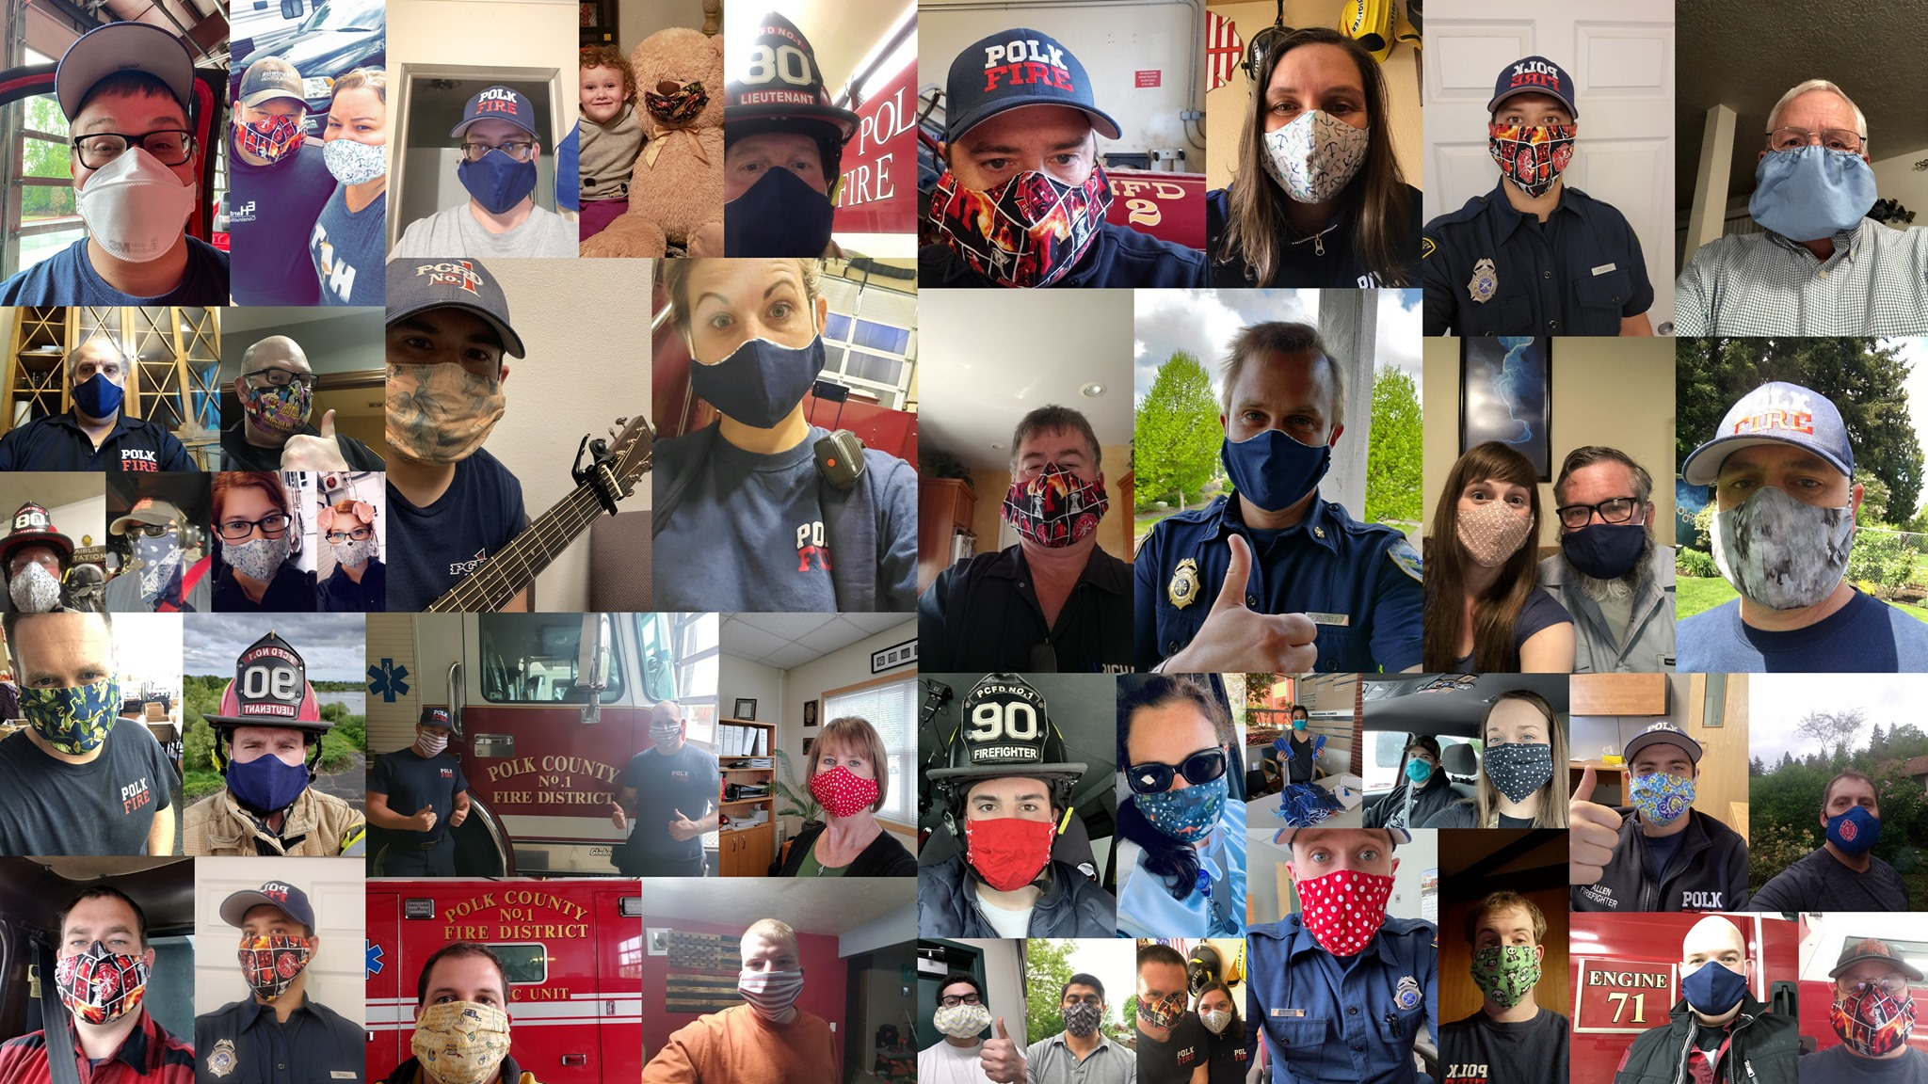
COVID Took a Lot of Time
Protocols
PPE
Isolation Rules
Changes to Academy
Zoom
Public Education
Parades
OSHA Rules
Firefighter/Paramedic Testing
AFG-S Grant
Drive Through Pancake Feed
Food Bank
Drilling

Slide 9
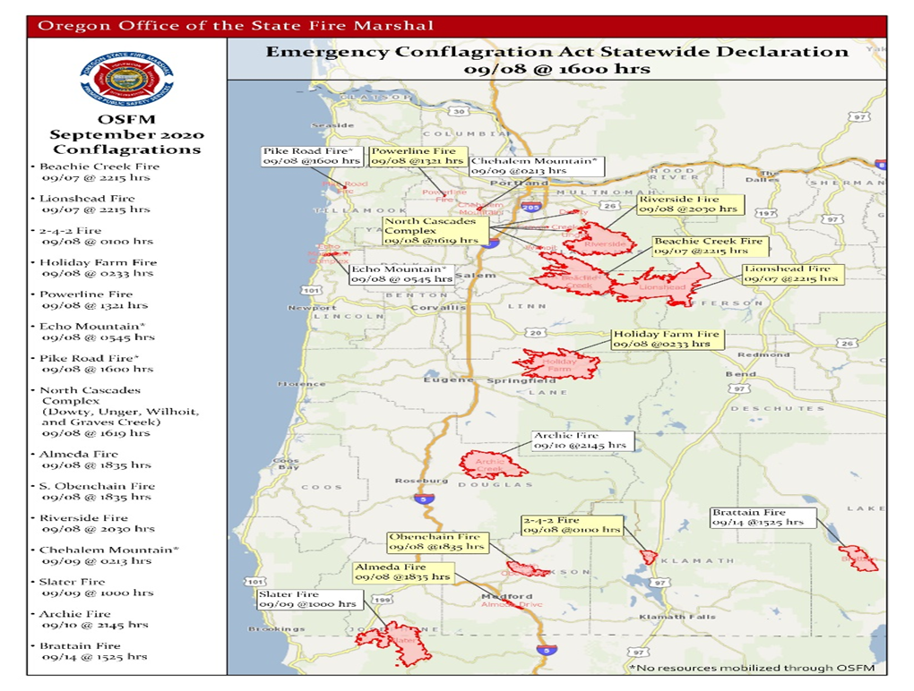
September 7th, 2020
43 phone calls between 10:30 pm and 6:30 am
Within one week we had deployed firefighters to Lincoln, Lane, Josephine, and Lake counties
180 fire agencies responded

Slide 10
Onward to 2021

